Slide 1
PIDs for Open Data
How GRID has enabled the Linked Open Data platform SN SciGraph

Slide 2
Brian Kirkegaard Lunn Senior Metadata Manager at Digital Science b.lunn@digital-science.com
Working with GRID and Dimensions

Slide 3
SN SciGraph
A linked Open Data platform for the scholarly domain
Collaborative effort between Springer Nature & Digital Science
Supporting internal use cases, but also contributing to an emerging web of linked science data
Semantic Web technology stack allows for scalable and expressive enterprise-level metadata management
Not just publications but a wealth of other related data

Slide 4
What brought me here today
‘Our vision is to create the largest state of the art linked data aggregation platform for the scholarly domain. We ingest data across internal and external data silos to transform it for re-usage across the entire enterprise and research area.’
Henning Schoenenberger, Director Data Development at Springer Nature

Slide 5
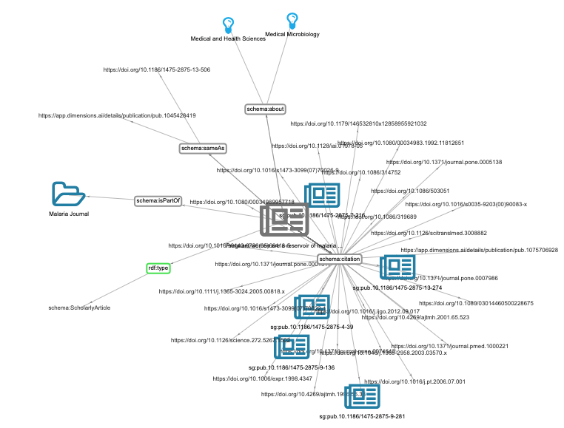
What brought me here today
2016 spark in SN to create an Open Linked Data Platform: SN SciGraph
“ingest internal and external data silos and transform it for re-usage”
In terms of SN SciGraph that means:
Authors
Source title
Subject areas
Citations
References
Grants
…

Slide 6
The data and links driving Dimensions...
119m
Altmetric data
points
980k links
517k
Clinical trials
107m
Publications improved metadata
of 74m
11m links
344k links
1.2bn links
10m links
39m
Patents
955k links
1.4m
Datasets
14m links 19m to funders
24k links
230k to funders
1.4m links
220m links
169k links
232k to funders
351k links
565k to funders
5m
Grants
$1.6 trillion in funding
452k
Policy documents
Status: January 2020

Slide 7
What brought me here today
2016 spark in SN to create an Open Linked Data Platform: SN SciGraph
“ingest internal and external data silos and transform it for re-usage”
In terms of SN SciGraph that means:
Authors
Source title
Subject areas
Citations
References
Grants
…
Affiliations

Slide 8
The problem is: Affiliations strings are hard :(
Cambridge Institute of Therapeutic Immunology & Infectious Disease (CITIID), Jeffrey Cheah Biomedical Centre, University of Cambridge, Puddicombe Way, Cambridge CB2 0AW, UK
=>
Department of Sociology, University of Cambridge, Cambridge, UK
!=>
Laboratory for Particle Physics and Cosmology, Harvard University, Cambridge, MA, United States

Slide 9
GRID to the rescue!
SN SciGraph needed help with the disambiguation of organisational source data
A persistent identifier for organisations was needed that was
Reliable
Robust
A trustworthy service was required that could
Be queried with the sometimes messy affiliation data
Return that PID reliably and robustly for the affiliations data

Slide 10
Affiliations strings aren’t hard anymore :)
The problem is: Affiliations strings are hard :(
Cambridge Institute of Therapeutic Immunology & Infectious Disease (CITIID), Jeffrey Cheah Biomedical Centre, University of Cambridge, Puddicombe Way, Cambridge CB2 0AW, UK
University of Cambridge: grid.5335.0
=>
Department of Sociology, University of Cambridge, Cambridge, UK
!=>
University of Cambridge: grid.5335.0
Laboratory for Particle Physics and Cosmology, Harvard University, Cambridge, MA, United States
Harvard University: grid.38142.3c

Slide 11
Missions of an organisation identifier - Capture data accurately
Solve your data capture woes by working with unambiguous institutional information from the start. GRID IDs will ensure your data is always perfectly consistent.

Slide 12
Missions of an organisation identifier - Ensure robust reporting
Align your data with GRID and open the door
to a range of data integration and reporting possibilities. Link to other datasets like ISNI, RoR, Wikidata or the Crossref Funder Registry seamlessly.

Slide 13
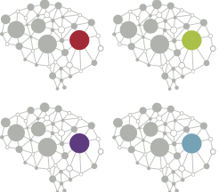
Missions of an organisation identifier - Disambiguate your data
With a structured organisation source theres is no more struggling to find duplicates in your data, or guessing if Cambridge is in the US or in Great Britain. The structure will ensure you have clean data.

Slide 16
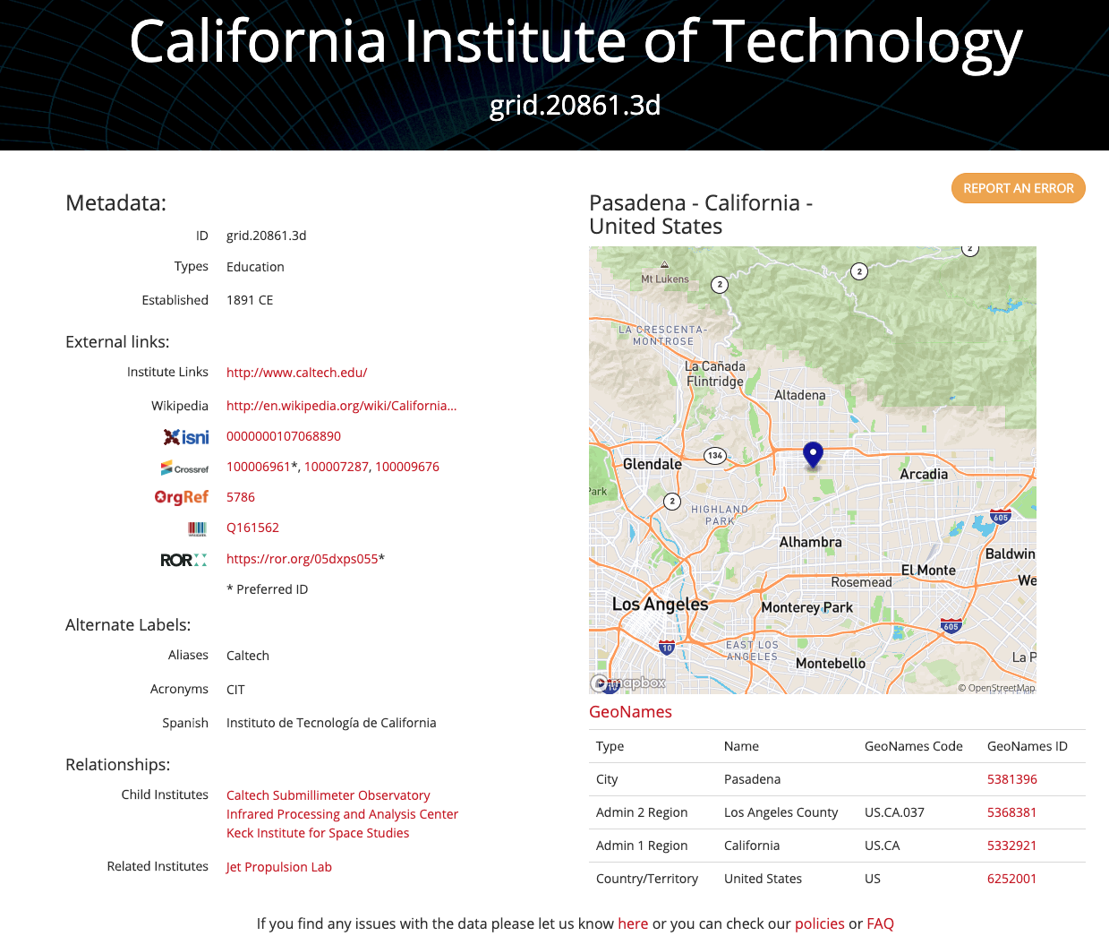
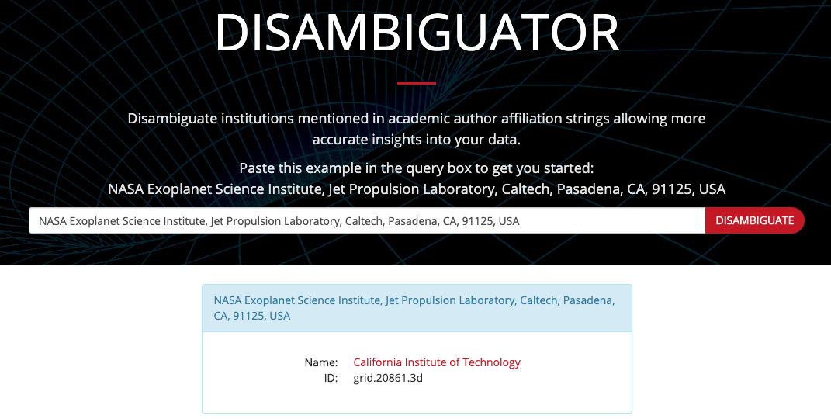

Slide 17
Who is using GRID?
@grid_ac

Slide 18
How GRID helps to create and run SN SciGraph
Publication affiliations are disambiguated using GRID
In bulk for historical data
As part of normal XML ingestion workflow for current and ongoing data
Newly discovered GRID identifiers are used to enrich the XML data
Existing content is continuously improved
SN SciGraph transform publications XML into RDF (JSON-LD)
GRID IDs are turned into full URIs (grid.9759.2 → https://www.grid.ac/institutes/grid.9759.2)

Slide 19
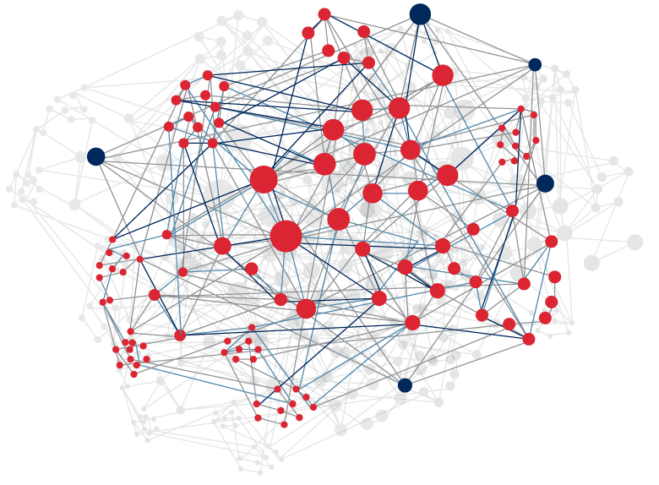
SN SciGraph: Facts & Figures
First public release in early 2017:
>8m scholarly articles, 4.4m chapters, 276k books, 438k grants, 361k patents, 32k clinical trials linked to publications of 7m researchers and 60k organisations
in terms of linked open data: 200 triples per document, 25 triples per person = almost 3 billion triples
Traffic: 58m hits in 2019
→ Almost 5m per month!

Slide 20
What we have learned
Learnings SN for SciGraph and GRID:
Disambiguation of affiliation strings at the very beginning of the publishing process is core and key to everything else downstream
Institutional organizations better covered than corporate research
What we would do differently today
Discrepancies have to be communicated more transparently and proactively
Raise awareness among clients (author, researchers) and colleagues about challenge and limitations of affiliation disambiguation

Slide 21
Why this success story?
SN SciGraph would not have been possible to this extent without GRID as the organisation PID
GRID helped to significantly improve the quality
With the disambiguation service
By providing PIDs robustly and reliably
Success: Thanks to GRID, SN SciGraph could be much more interconnected \o/
GRID database can be downloaded by everyone and is CC0: public domain → Everybody can benefit!
GRID disambiguation service available via the Dimensions API

Slide 22
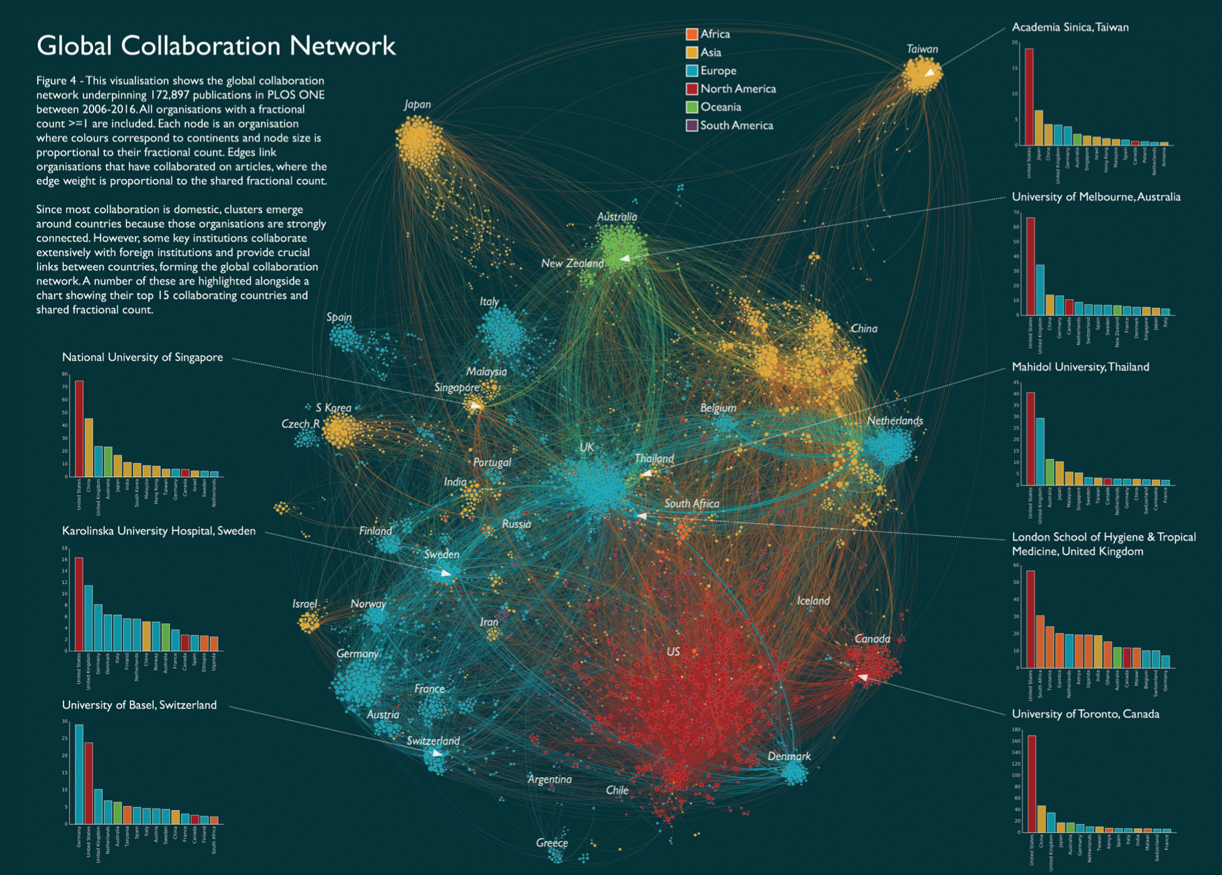
Questions?
Thank you!
Contact us at
b.lunn@digital-science.com
scigraph@springernature.com

Slide 23
If you want to know more...
You can find SN SciGraph here: https://www.springernature.com/gp/researchers/scigraph
SN SciGraph Explorer: https://scigraph.springernature.com/explorer
GRID: https://grid.ac/
GRID Disambiguation service via Dimensions API: https://www.dimensions.ai/dimensions-apis/

